Slide 1


PEARMUND CELLARS
WINERY DATA WAREHOUSE
Team GRK

Slide 2
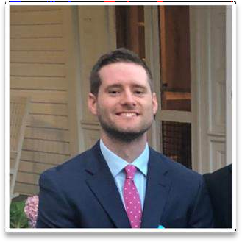




TEAM MEMBERS
2
Sean Corry Scrum Master
Satwik Pandapragada Developer
Ishan Patel
Product Owner
Rishitha Madipelli Developer
Dhananjay Nunna Developer

Slide 3
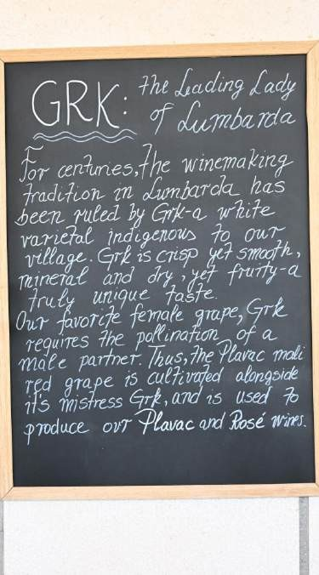


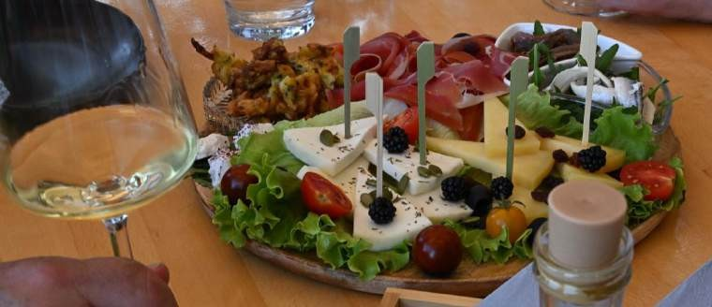
GRK AND VINA SABULUM
3

Slide 4
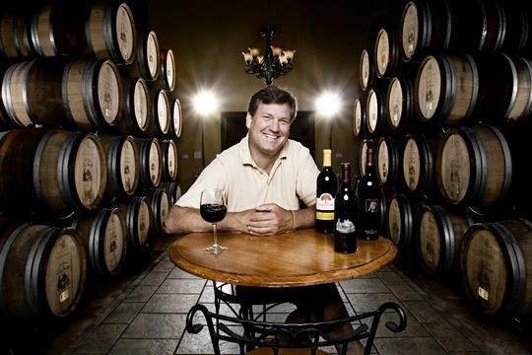

PARTNERS
4
Chris Pearmund: Managing Partner
John Memoli: Operations Manager

Slide 5


PROBLEM STATEMENT
5
Three separate systems for each winery make analysis difficult
Singular solution to integrate the data, then data from each winery can be analyzed separately and together to help with analytics
A Data Warehouse is a possible Solution
Platform as a Service and Software as a Service

Slide 6
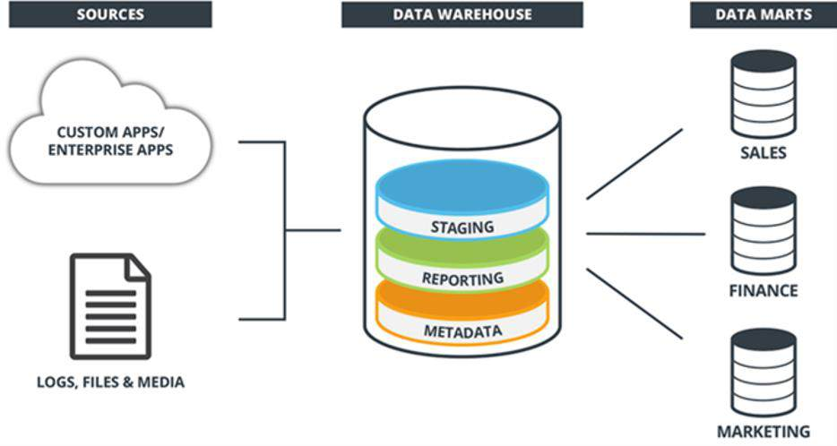
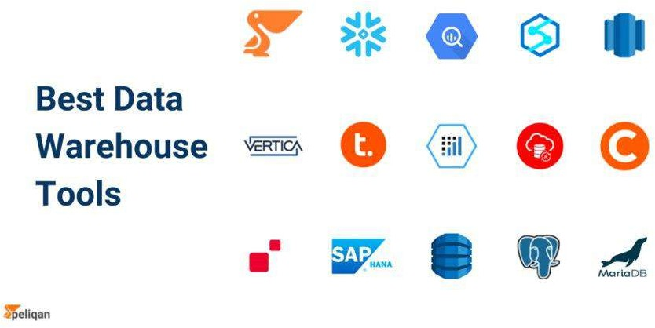
DATAWARE HOUSE SOLUTION
6
Integration of structured and semi-structured data from diverse sources:
Direct-to-Consumers (DTC) Transactions
Marketing Platform
Reservation System
Unified storage of current and historical data for
streamlined analysis and reporting.

Slide 7
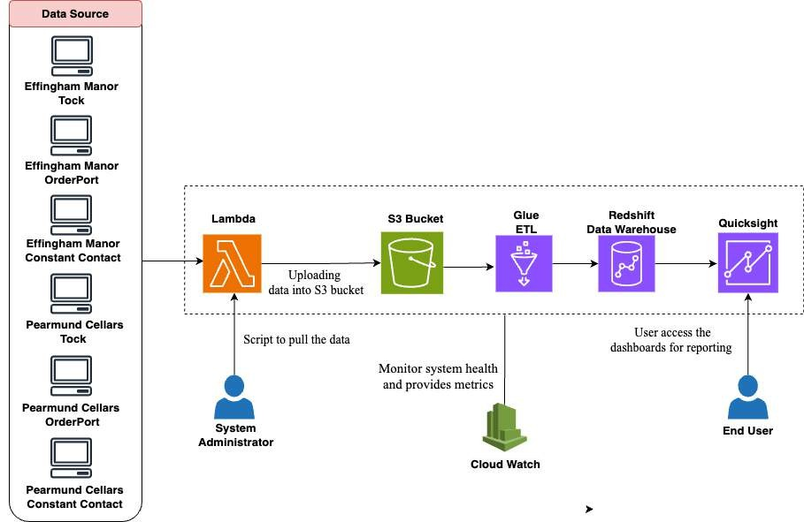
ARCHITECTURE 1 - SaaS (Software as a Service)
7

Slide 8
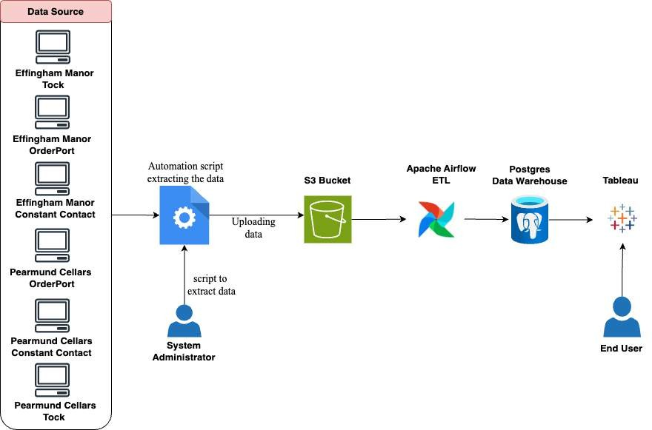
ARCHITECTURE 2 – PaaS (Platform as a Service)
8

Slide 9
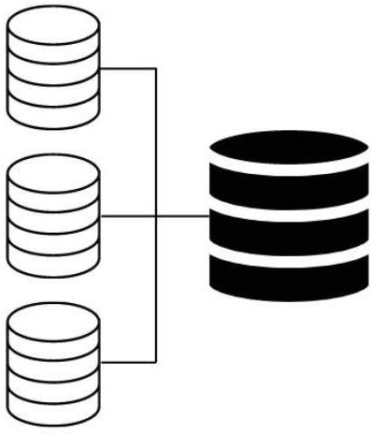
EXTRACTION
9

Slide 10


DATASETS
10
Tock (Transactions & Guest Report)
OrderPort (Catalog Report, Customer Account, & Ordered
Products)
Constant Contact (Email Campaigns Report & Contact Export)
Additionally Lists of Barrel Owners and Wine Club Owners
Separate and propriety data for each winery

Slide 11


Data
11
Data was not cleaned
Information was not recorded in the same manner or recorded at all, across the wineries or at the same winery
Including Names and Emails
Accessibility was limited due to PII

Slide 12

STORAGE
12
The predetermined datasets were placed in the S3 Bucket by POC
Went through all datasets in person with POC
S3 Bucket costs only a few cents to use as storage

Slide 13

TRANSFORMATION
13

Slide 14

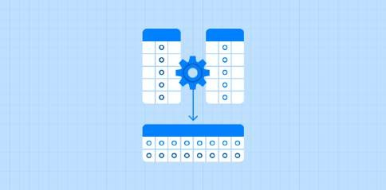
MODIFYING THE DATA
14
Names and Emails needed to be modified to be in the same format
Emails changed to be lower case, and Names were all changed to same format of: First Last
Certain columns needed to be excluded
Certain pieces of data not used and others not relevant to the necessary analytics
Empty records in columns that remained were removed

Slide 15

LOADING
15

Slide 16
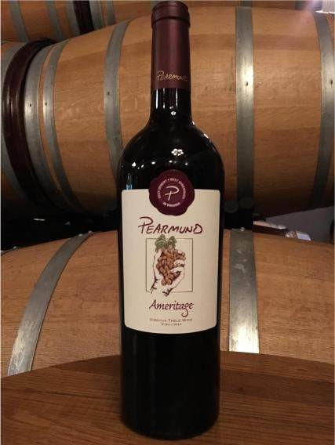
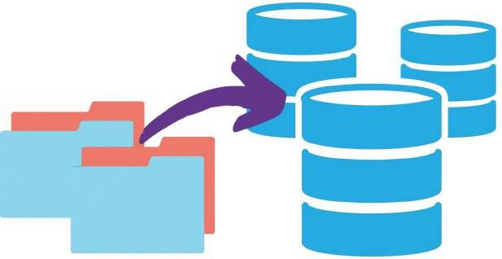
DATA IMPORTING
16
Created tables using Data Definition Language (DDL) statements
Built Pipelines to load the data into the tables

Slide 17




SCRIPTING
17
New data needs to be imported monthly for analysis
Adding this new data is achieved via a Python script
Able to track the last customer and newest customer by pulling the Customer Number in the Customer Records
Old Cust#
Script
New Cust#

Slide 18
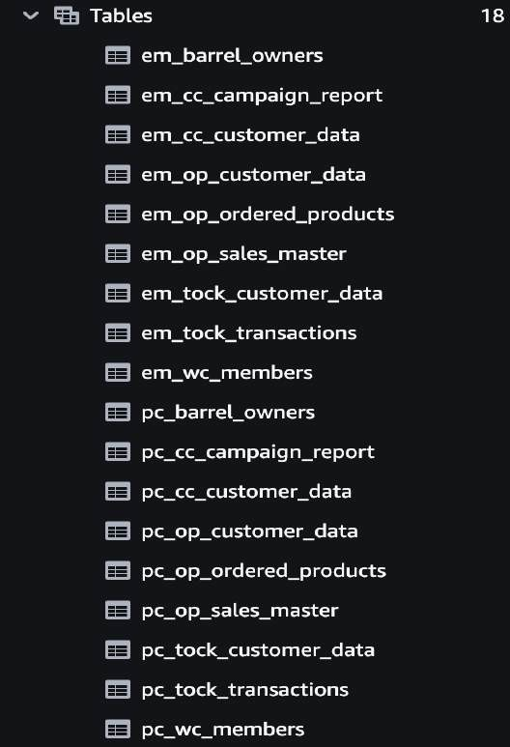
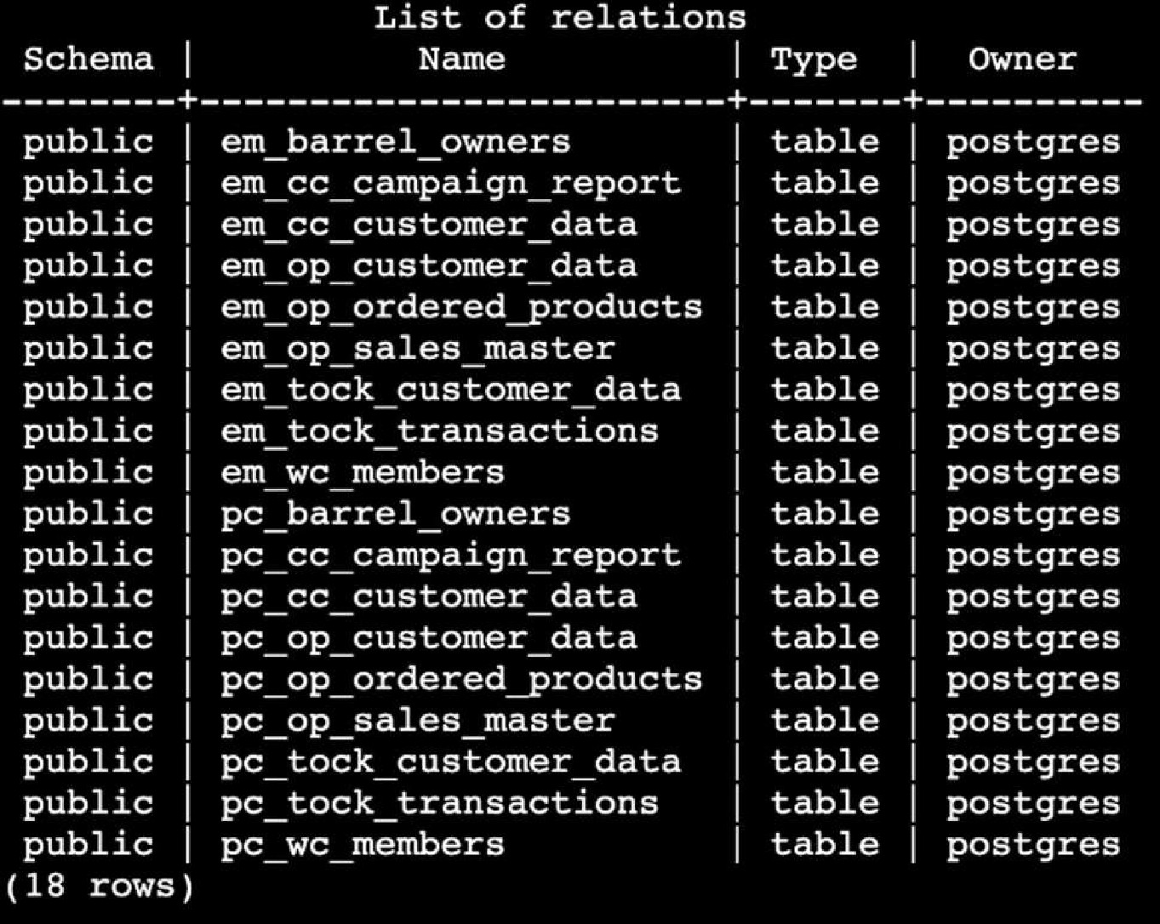
DATA WAREHOUSE TABLES
18
Tables in Redshift (SaaS)
Tables in Postgres (PaaS)

Slide 19
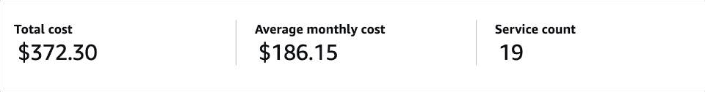
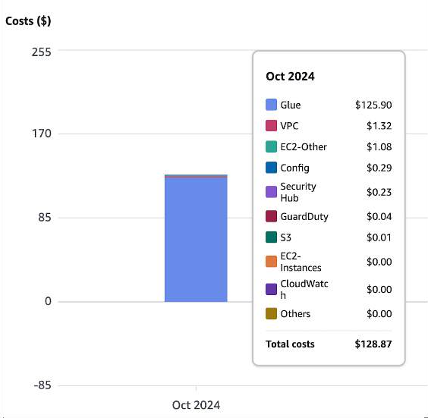
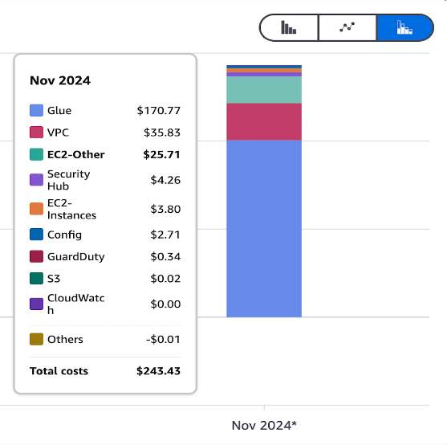
COSTS
19
Unique Costs
Description | Costs
Glue | $ 296.67
Redshift | $ 28.16
Total for SaaS | $ 324.83
Description | Costs
EC2 Instance | $ 25.71
Total for PaaS | $ 25.71

Slide 20
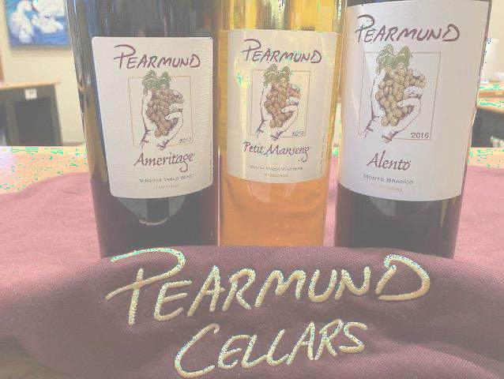
QUERIES AND ANALYSIS
20

Slide 21
How many people who bought a ‘tasting’, also bought a ‘bottle’?
21
Month | Total Tastings | Tasting and Bottle | Percentage
January | 47 | 30 | 63.83%
February | 52 | 26 | 50%
March | 82 | 44 | 53.66%
April | 72 | 42 | 58.33%
May | 81 | 40 | 49.38%
June | 98 | 63 | 64 .29%
July | 89 | 46 | 51.69%
August | 58 | 27 | 46.55%
September | 61 | 31 | 50.82%
October | 110 | 66 | 60%
Month | Total Tastings | Tasting and Bottle | Percentage
January | 69 | 35 | 50.72%
February | 63 | 24 | 38. 10%
March | 68 | 37 | 54.41%
April | 99 | 53 | 53.54%
May | 76 | 37 | 48.68%
June | 79 | 44 | 55.70%
July | 57 | 34 | 59.65%
August | 72 | 41 | 56.94%
September | 60 | 35 | 58.33%
October | 68 | 48 | 70.59%
Pearmund Cellars
Effingham Manor

Slide 22
Who purchased the most Rose and Kings Ransom at Effingham Manor?
22
Last Name | Rose Bottles Count
Triplett | 77
Segal | 26
Rafferty | 26
Pearson | 19
Hurt | 18
Wiley | 15
Martin | 12
Garber | 11
May | 10
Bloom | 10
Last Name | Kings Ransom Bottles Count
Lutender | 32
Schmidt | 24
Segal | 19
King | 14
Yost | 13
Triplett | 12
Kaplan | 12
Tribbey | 11
Ousley | 11
Riveria | 10

Slide 23
Who purchased the most Chardonnay and 8th Mission Black Ops at Pearmund Cellars?
23
Last Name | Chardonnay Bottles Count
Kessler | 48
Stewart | 40
Kirkman | 30
Webb | 29
Shifflett | 18
Mumbach | 14
Cain | 14
Kantor | 13
Fenwick | 12
Kessler | 48
Last Name | 8th Mission Black Ops Bottles Count
Elnattar | 84
Mulcahy | 16
Stevens | 13
Shanahan | 13
Taylor | 13
Pearmund | 12
Shifflett | 12
Sellersmartine | 12
Vaughn | 12
Schmidt | 10

Slide 24
Which individuals made the highest transactions?
24
Last Name | Total Revenue
Looney | $ 6,402.17
Paradis | $ 4,829.42
Crooks | $ 4,817.60
Kessler | $ 3,693.93
Smith | $ 3,410.25
Stewart | $ 3,151.87
Webb | $ 3,097.21
Henderson/Marshall | $ 3,032.64
Wilkey | $ 2,764.99
Pickett | $ 2,757.61
Last Name | Total Revenue
Gyles | $ 4,630.65
Triplett | $ 4,165.8
Segal | $ 3,972.05
Mello | $ 3,621.38
Morrow | $ 3,548.35
Hawkins | $ 3,324.38
Beber | $ 3,197.22
Cloran | $ 2,691.45
Schmidt | $ 2,599.01
Smith | $ 2,487.71
Pearmund Cellars
Effingham Manor

Slide 25
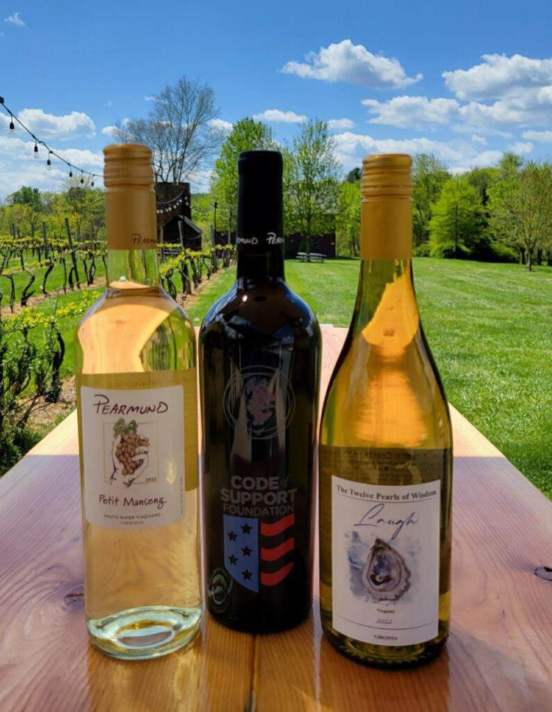
VISUALIZATIONS AND ANALYSIS
25

Slide 26
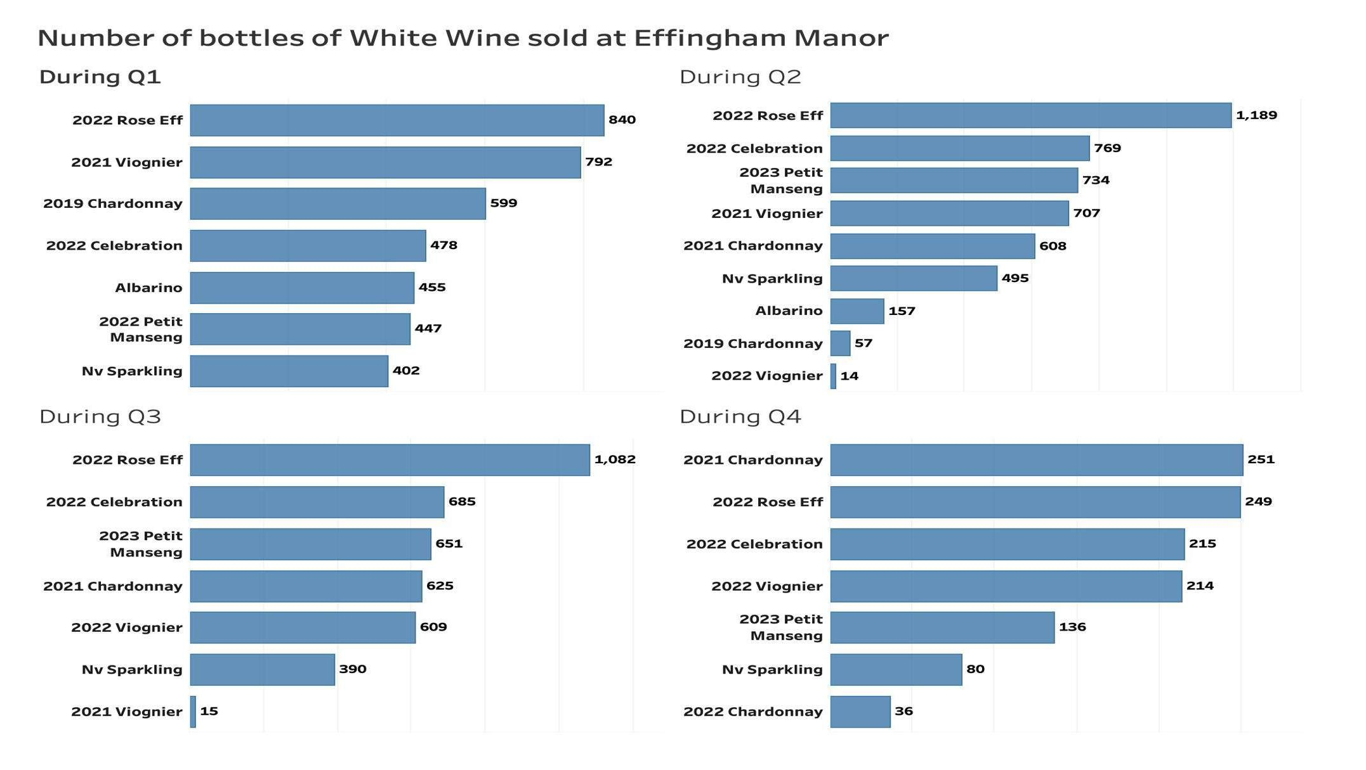
26

Slide 27
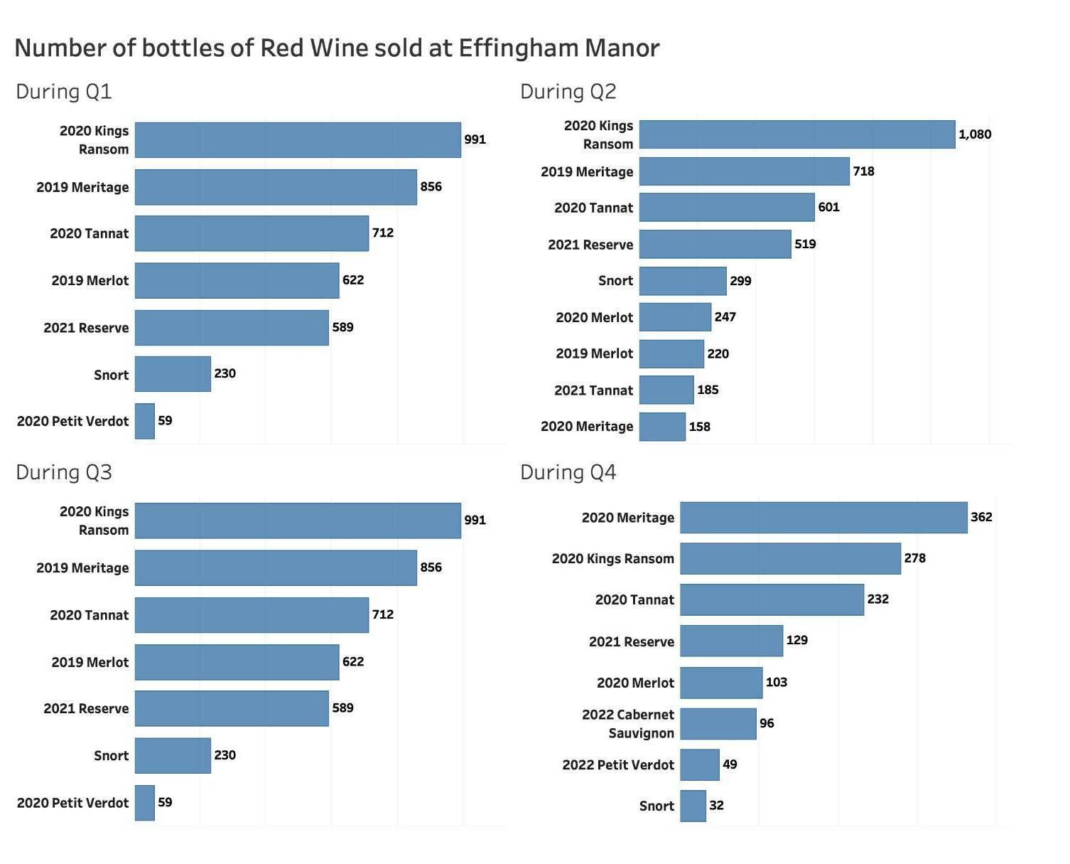
27

Slide 28
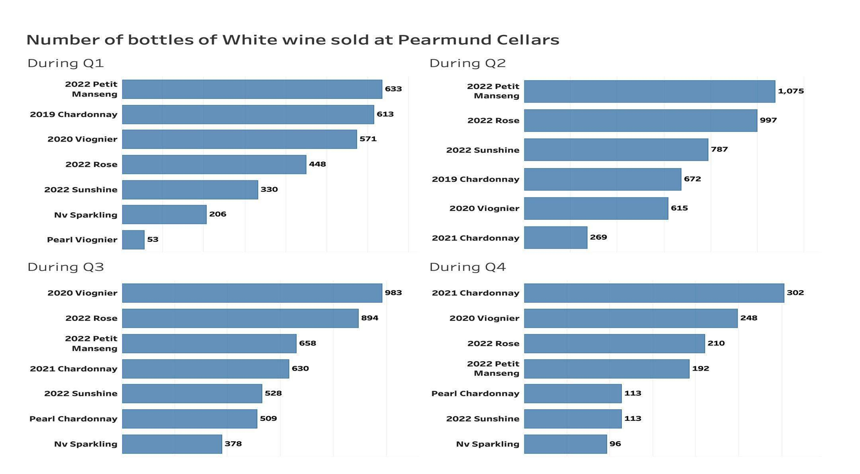
28

Slide 29
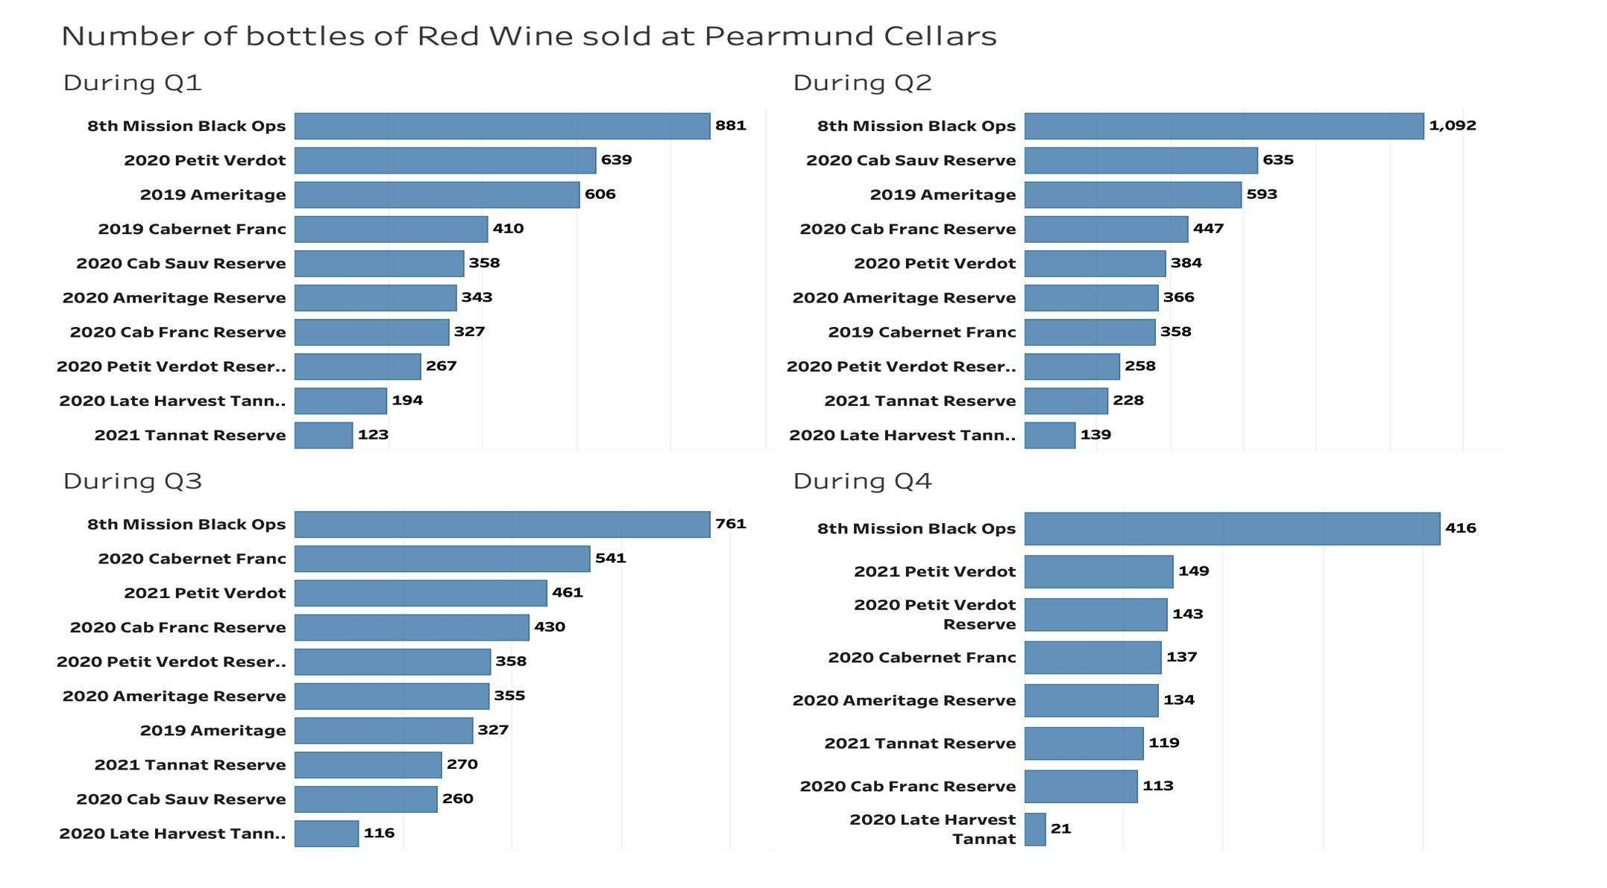
29

Slide 30
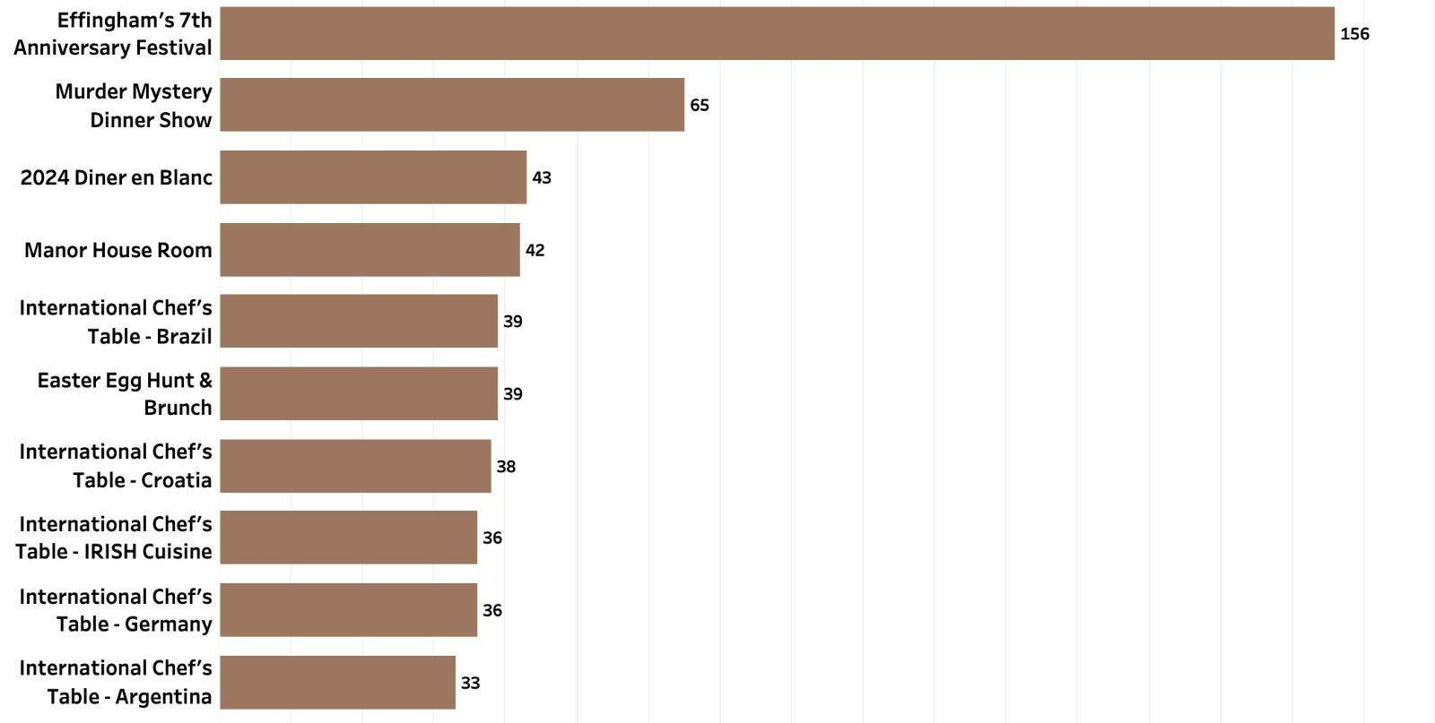
Most number of reservations made for events at Effingham Manor
30

Slide 31
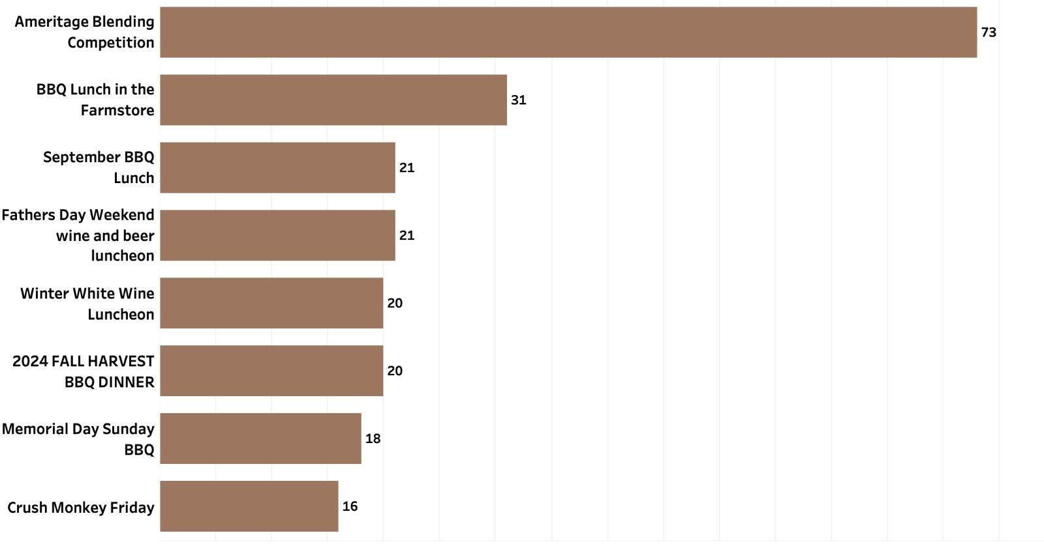
Most number of reservations made for events at Pearmund Cellars
31
1

Slide 32
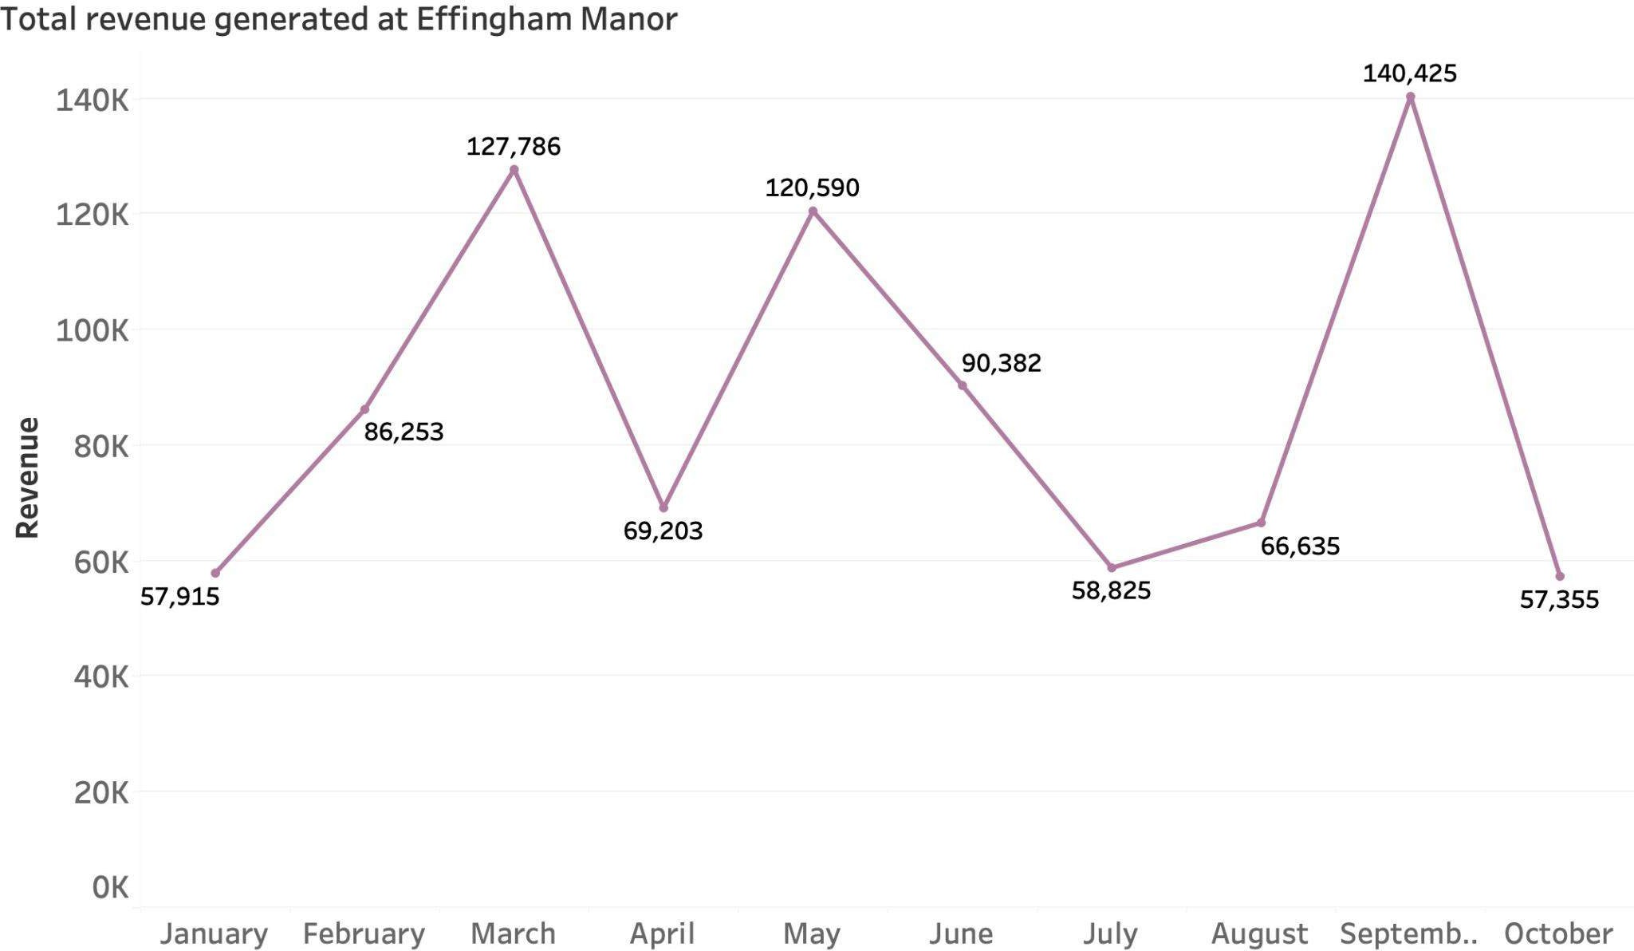
33

Slide 33
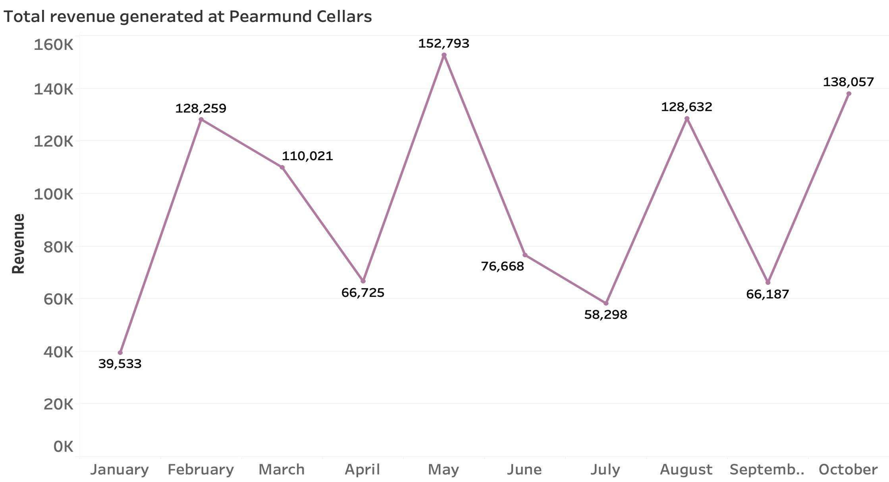
32

Slide 34
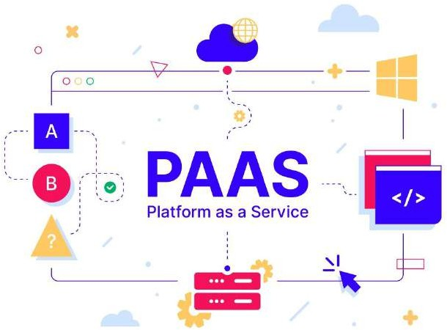
FINDINGS AND DECISIONS
34
PaaS is slightly faster than SaaS
PaaS is cost-effective like SaaS but overall is a cheaper option offering the same
quality
PaaS is better for the smaller datasets of the wineries
PaaS is the best viable solution going forward

Slide 35

SUMMARY
35
Implementation of a data warehouse needed to be done following last Semester
Two cost-effective and easily maintainable data warehouses were prototyped: PaaS (Ec2) and SaaS (Amazon Redshift)
Through review and transformation of the data, the need to practice Data Cleaning prevalent
Testing of simple analytics was done to help illustrate descriptive, useful information available via a data warehouse
Led to the decision that PaaS is more cost-
effective and is a viable solution

Slide 36

NEXT STEPS
36
In-depth research and evaluation of PaaS is necessary to identify potential changes with PaaS, that could lower costs and simplify operations within the data warehouse.
Data completeness and data consistency need to be improved so it can help create more detailed analytics and allow for better comparison between both wineries

Slide 37
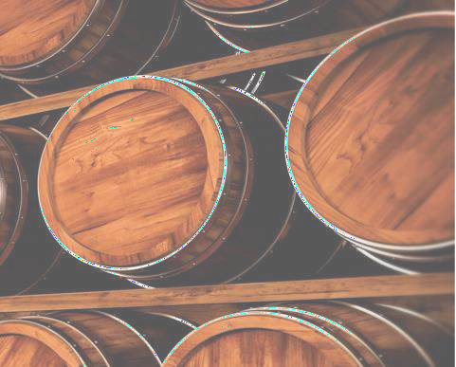

Q & A
1

Slide 38

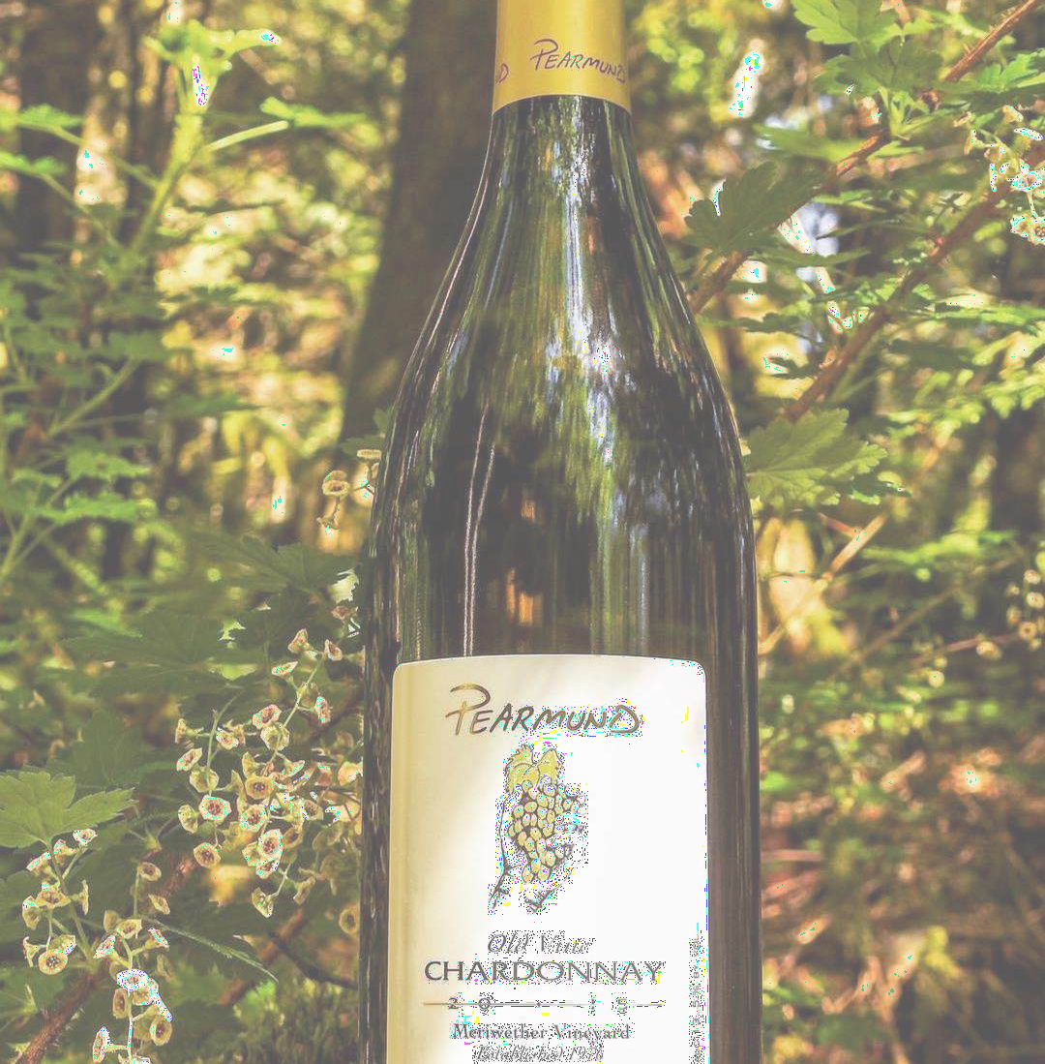
THANK YOU

